Slide 1
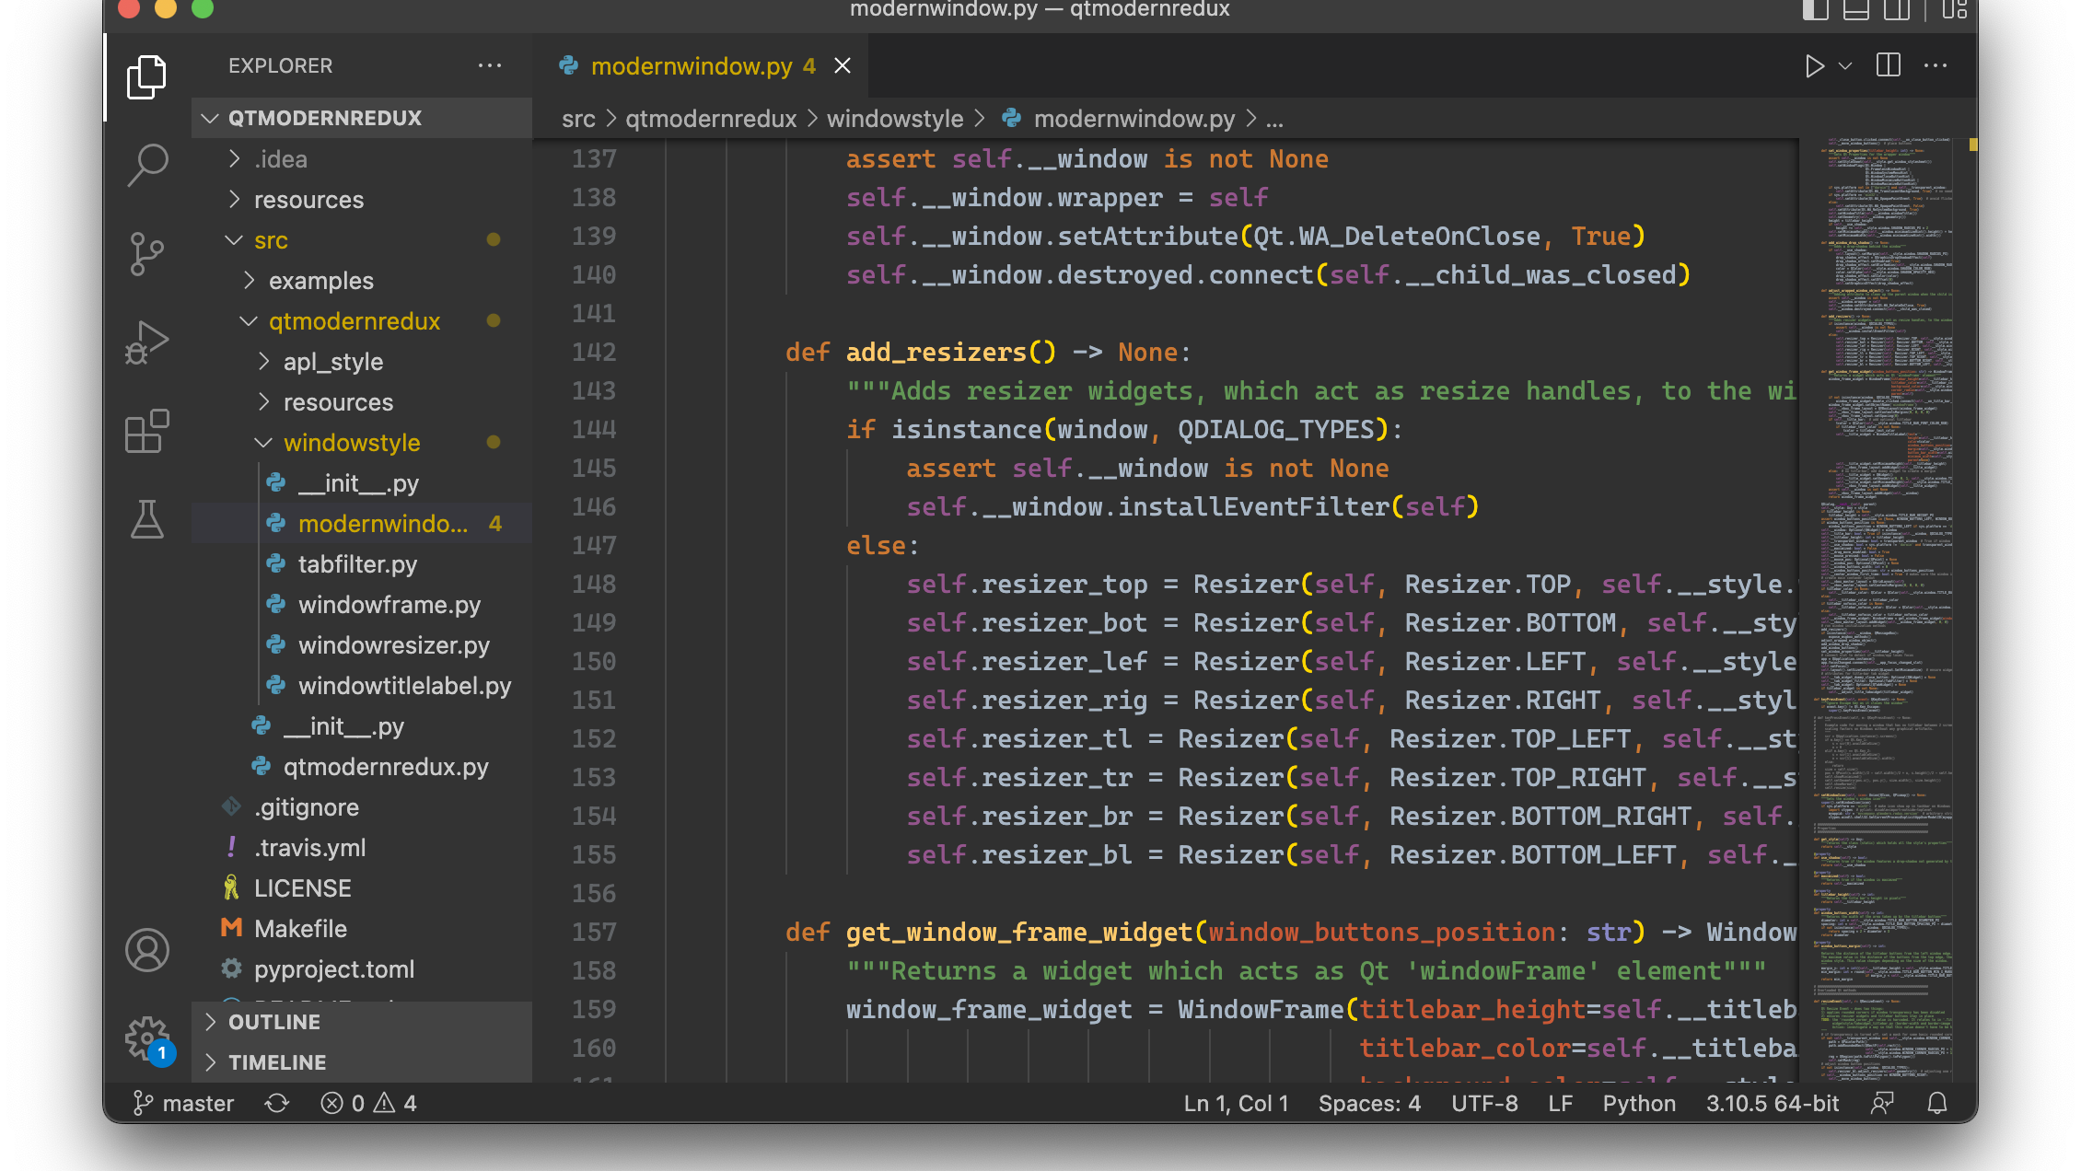
AI SEARCH ALGORITHMS
River Crossing
Problem Solver
An Interactive Visualization of Classic AI Search Algorithms
Python
AI
GUI

Slide 2
PRESENTATION OVERVIEW
Contents
01
Problem Definition
02
Algorithm Overview
Understanding the classic Missionaries and Cannibals problem, its constraints, and state space representation.
Five search algorithms: BFS, DFS, A*, Greedy, and CSP with comparative analysis framework.
03
Implementation
04
GUI Features
System architecture, modular design, and the GUI application structure built with Tkinter.
Interactive visualization, animation system, and user experience design elements.
05
Performance Analysis
Algorithm benchmarking, performance metrics comparison, and technical implementation highlights.

Slide 3
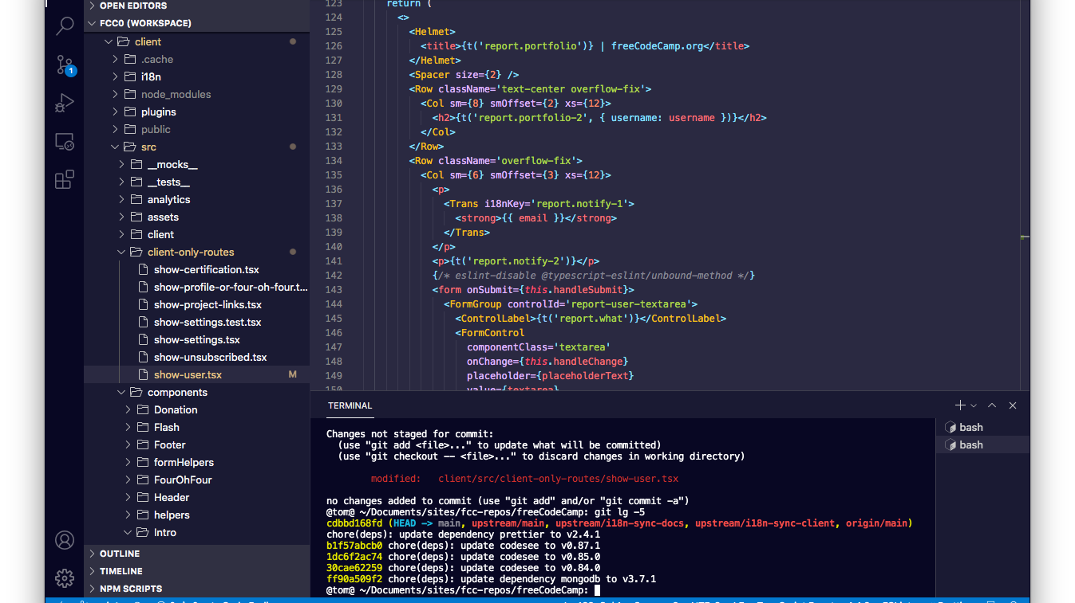
01
Problem
Definition
Understanding the classic Missionaries and Cannibals problem

Slide 4
PROBLEM DEFINITION
The River Crossing Challenge
Problem Scenario
State Representation
Three missionaries and three cannibals stand on the left bank of a river. They have a boat that can carry at most two people at a time. The challenge is to transport everyone safely to the right bank.
Each state is represented as a tuple: (M, C, B)
M:
Missionaries on left bank (0-3)
C:
Cannibals on left bank (0-3)
This classic problem, first formulated in the late 1870s, serves as a fundamental test case for AI search algorithms and state space exploration.
B:
Boat position (1 = left, 0 = right)
The Critical Constraint
Initial State
Goal State
(3, 3, 1)
(0, 0, 0)
Missionaries cannot be outnumbered by cannibals on either riverbank. If this constraint is violated at any point, the missionaries will be eaten.
All on left bank
All on right bank
Valid: 3M, 2C | Invalid: 1M, 2C

Slide 5
PROBLEM ANALYSIS
Constraints & State Space
Core Constraints
Invalid State Examples
1
Boat Capacity
Maximum 2 people per trip
(1, 2, 0)
(2, 3, 1)
2
Safety Condition
Left Bank: 1M, 2C
Left Bank: 2M, 3C
Missionaries ≥ Cannibals when present
Cannibals outnumber missionaries
Cannibals outnumber missionaries
3
Boat Operation
At least one person required
INVALID
INVALID
Valid State Examples
State Transition Example
(3, 3, 1) → Initial state
(3, 3, 1) → Send 2C → (3, 1, 0)
(3, 1, 0) → Safe: 3M ≥ 1C
(3, 1, 0) → 1C returns → (3, 2, 1)
Each transition must maintain safety constraints.
(0, 0, 0) → Goal state
State Space Size: 32 valid states out of 64 possible combinations.

Slide 6
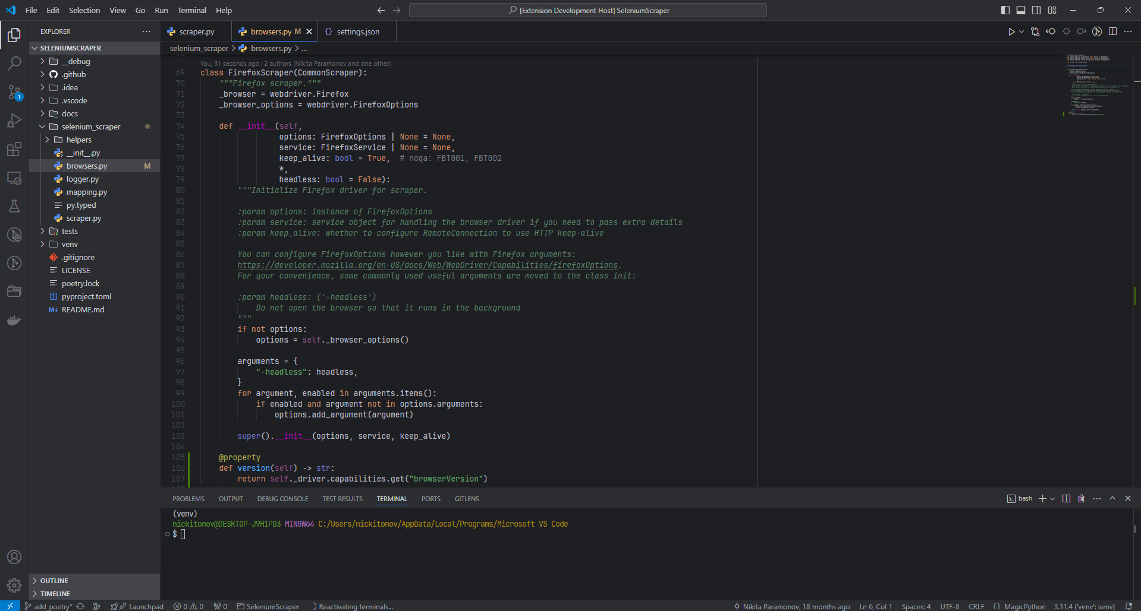
02
Algorithm
Overview
Five search algorithms to solve the problem

Slide 7
ALGORITHM OVERVIEW
Search Algorithm Fundamentals
BFS
DFS
A*
Greedy
CSP
Breadth-First Search explores all nodes at the current depth before moving deeper. Guaranteed to find the shortest path.
Depth-First Search explores as far as possible along each branch before backing up. Memory efficient but may not find optimal path.
A* Search uses heuristic guidance to find optimal paths efficiently. Combines actual cost with estimated remaining cost.
Greedy Search selects paths based solely on heuristic estimates, without considering path cost. Fast but not guaranteed optimal.
Constraint Satisfaction treats the problem as a set of variables with constraints, using backtracking and constraint propagation.
Complete:
Yes
Complete:
No
Complete:
Yes
Complete:
No
Approach:
Backtrack
Optimal:
Yes
Optimal:
No
Optimal:
Yes
Optimal:
No
Propagation:
DFS
Time:
O(b^d)
Time:
O(b^m)
Heuristic:
Admissible
Heuristic:
Admissible
Optimal:
Variable
Algorithm Selection: Each algorithm offers different trade-offs. BFS guarantees optimality but explores many states. DFS uses less memory but may miss the optimal path. A* combines the best of both using heuristics. Greedy is fast but may sacrifice optimality. CSP provides a structured constraint-based approach.

Slide 8
PERFORMANCE METRICS
Algorithm Comparison Framework
Path Length
Nodes Explored
Time (ms)
Measures the number of moves required to reach the goal state from the initial state. This metric indicates solution quality and algorithm optimality.
Counts the total states visited during the search process. This reveals the algorithm's exploration efficiency and computational overhead.
Measures execution duration in milliseconds. Combines algorithm efficiency, implementation quality, and Python overhead.
Calculation:
len(path) - 1
Impact: Fewer nodes = better efficiency
Formula:
time_sec × 1000
Lower values indicate more direct, efficient solutions.
A* with good heuristic explores fewer nodes than BFS.
Includes search time plus solution path reconstruction.
Comparison Mode
Optimal Solution
The GUI includes a "Compare All Algorithms" feature that runs all five solvers and displays a comprehensive results table for side-by-side analysis.
The river crossing problem has an optimal solution of 11 moves. Algorithms that find this solution while exploring minimal nodes are considered superior.

Slide 9
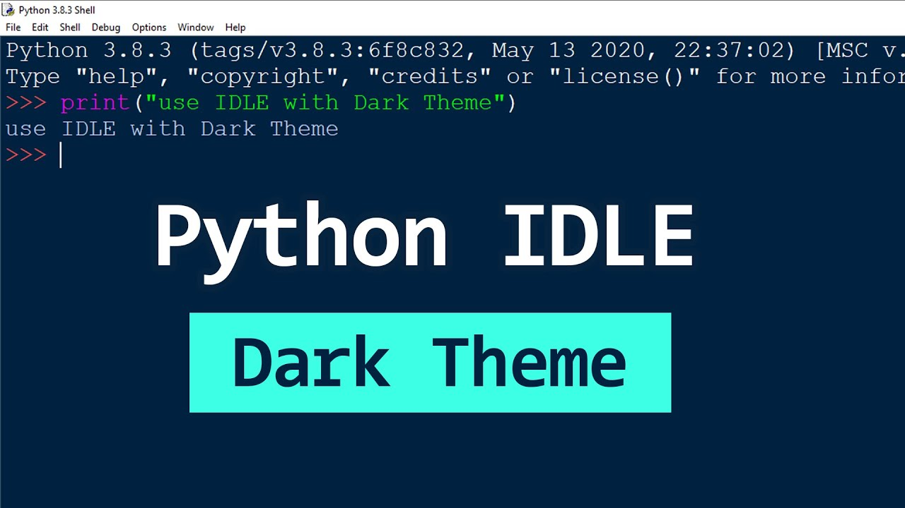
03
Implementation
Architecture
System design and code structure

Slide 10
CODE ARCHITECTURE
Project Structure & Modules
main.py
search/ Directory
Algorithm Runner & Comparator — Executes all five search algorithms and displays comparative results in a formatted table.
Contains implementations of all five search algorithms. Each module exports a solve() function with consistent interface.
Key Functions:
bfs.py
dfs.py
astar.py
greedy.py
csp.py
• Runs all 5 algorithms
Breadth-First
Depth-First
A* Search
Greedy
CSP
• Validates solutions
• Prints comparison table
Interface:
solve() → (path, nodes, time)
• Handles exceptions
gui.py
core/ Directory
Tkinter GUI Application — Interactive visualization with animation, controls, and real-time metrics display.
Contains the problem logic and state representation. Defines constants, goal state, and transition functions.
river_crossing.py:
Main Class:
• INITIAL_STATE = (3, 3, 1)
• RiverCrossingApp
• GOAL_STATE = (0, 0, 0)
• Animation engine
• State validation functions
• Event handling
• Successor state generation
• Audio system

Slide 11
GUI DESIGN
GUI Application Architecture
Initialization
Animation Engine
•
Window setup (800×600, fixed size)
•
State transitions (embark → cross → disembark)
•
Canvas creation for drawing
•
Smooth character movement
•
Solver registration (5 algorithms)
•
Configurable animation speed
•
Audio system initialization
•
Real-time scene rendering
Menu System
Interactive Controls
•
Algorithm selection buttons
•
Pause/resume simulation
•
Comparison mode option
•
Metrics overlay toggle
•
Custom button rendering
•
Volume control slider
•
Hover effects and interactions
•
Return to menu / End game

Slide 12
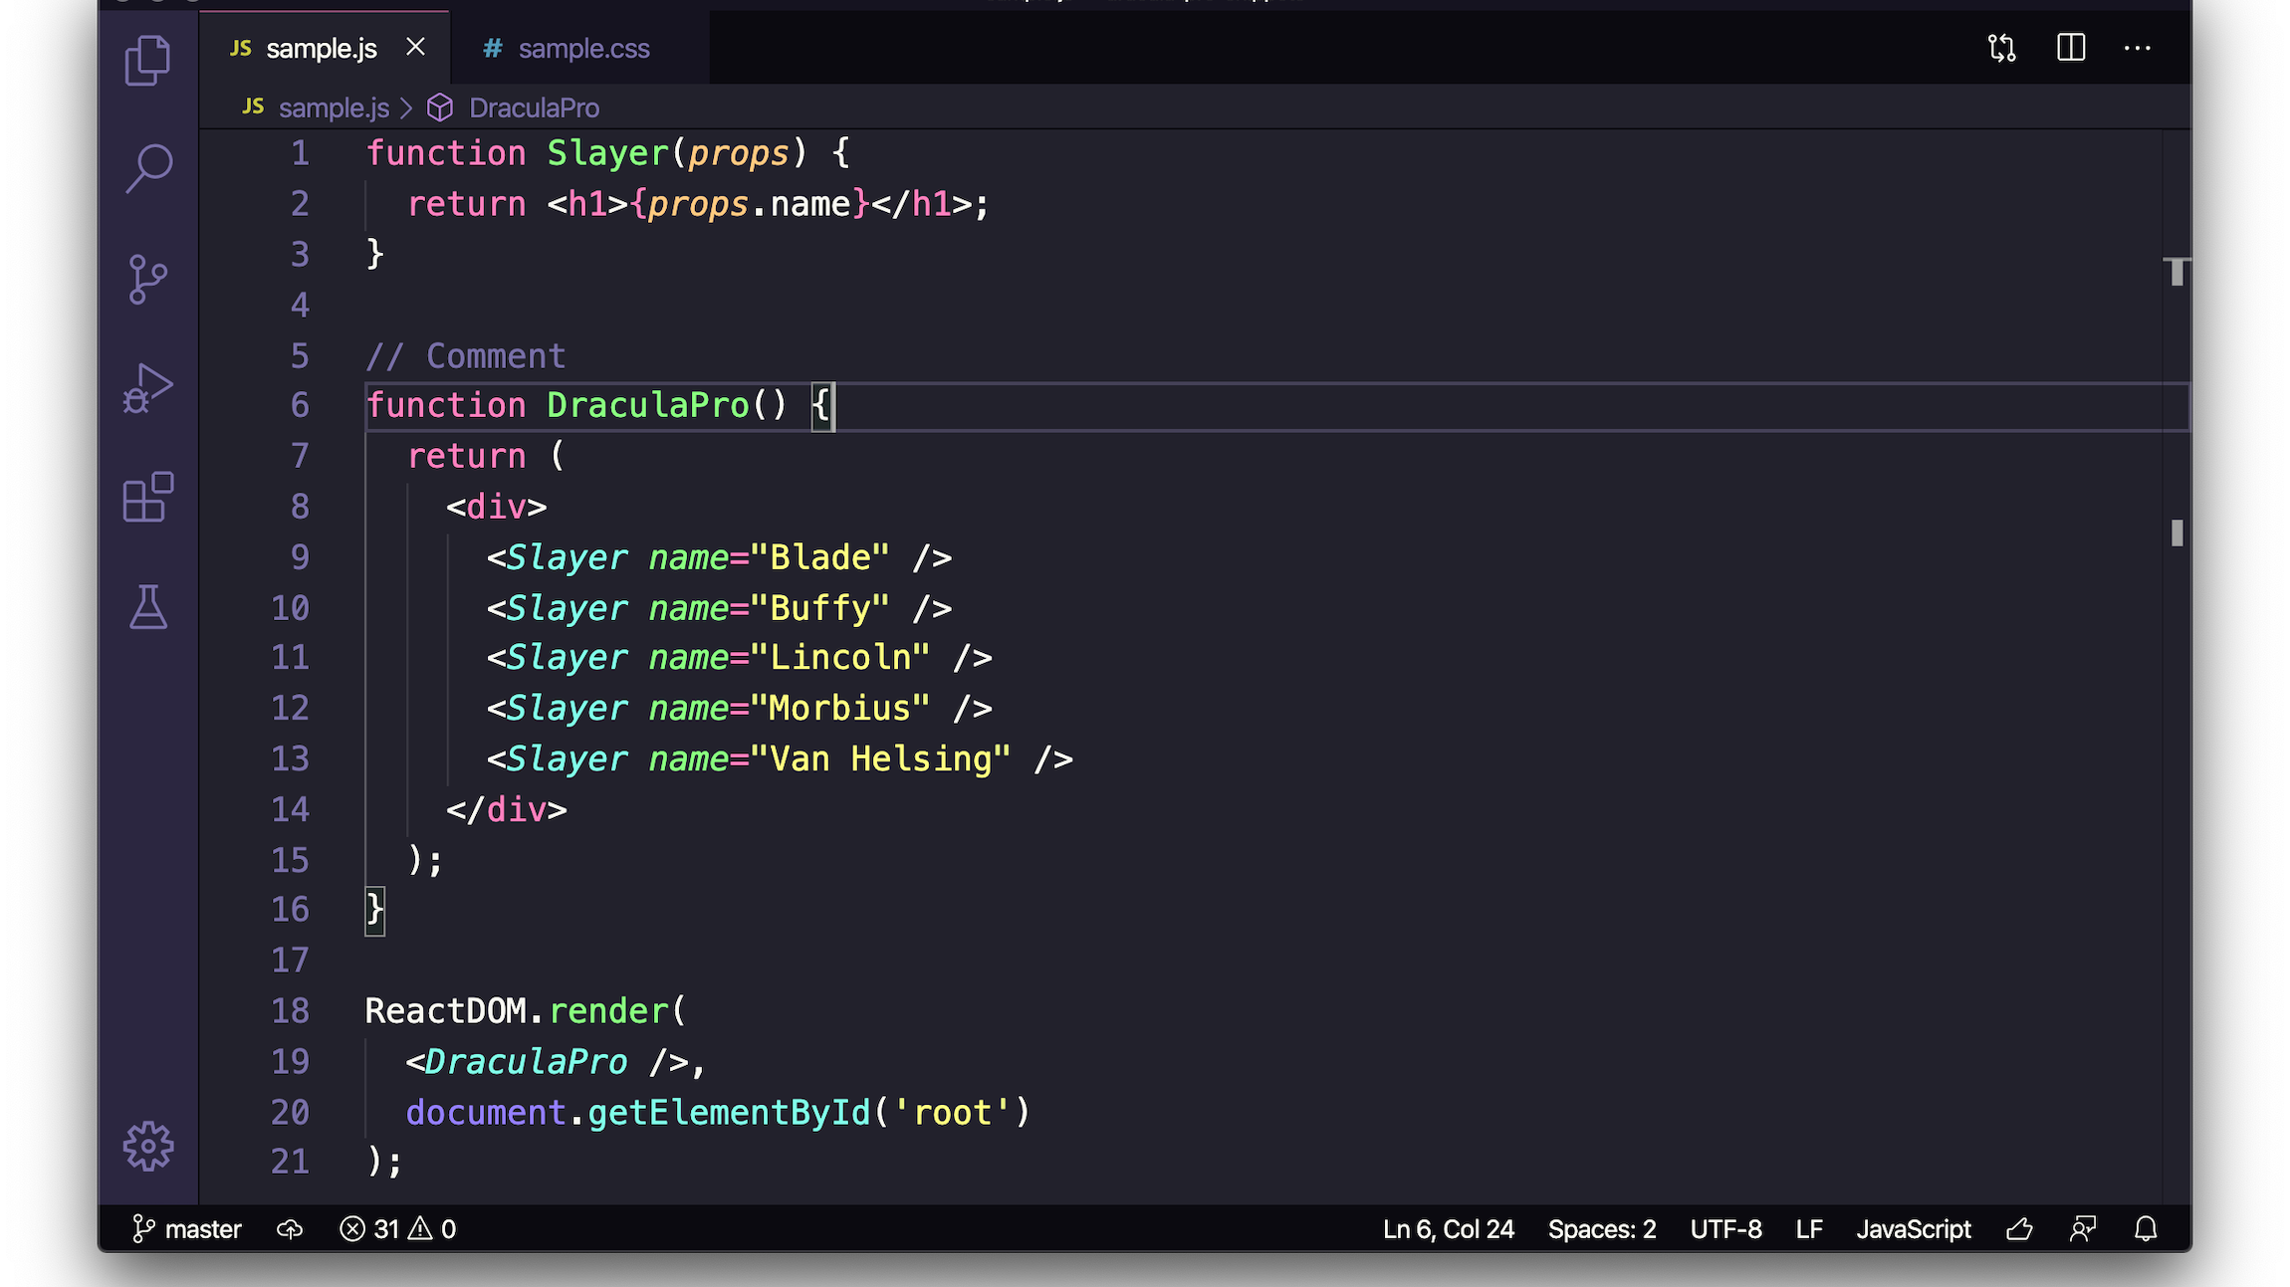
04
GUI Features &
Interaction
Interactive visualization and user experience

Slide 13
VISUALIZATION
Visual Design & Animation System
Visual Elements
Animation Phases
Sky & River Scene
1
Embark Phase
Atmospheric background with sky gradient and water
Characters move from riverbank to boat seats. Animation shows smooth interpolation from bank coordinates to boat positions.
Riverbanks
Left and right banks with distinct land texture
Wooden Boat
2
Crossing Phase
Trapezoid hull with plank details and seating
Boat traverses the river with passengers. Characters remain seated while boat moves horizontally across the water.
Character Design
3
Disembark Phase
Missionary
Cannibal
Characters exit boat to destination bank. Animation calculates target positions based on existing characters on destination.
Gold robe with cross detail
Orange-red with spear
Implementation: Uses root.after(20, ...) for smooth 50 FPS animation with configurable speed and pause/resume functionality.

Slide 14
USER EXPERIENCE
Interactive Controls & Features
User Interactions
Audio System
Algorithm Selection
Background music integration using Pygame mixer with looped playback and volume control.
Click algorithm buttons to run individual solvers
Comparison Mode
Volume Button: Toggle slider visibility
"Compare All" runs all 5 algorithms simultaneously
Animation Controls
Slider: 0-100% volume control
Pause/resume simulation, restart current algorithm
Loop: Music plays indefinitely
Metrics Overlay
Navigation
Real-time performance data display showing current algorithm, path length, nodes explored, and execution time.
Return to Main Menu
Restart Current Algorithm
Toggle: Click "Metrics" button in top-left corner during simulation
End Game / Exit
Success State: When goal is reached, "Goal Reached!" message appears with options to return to menu or restart.

Slide 15
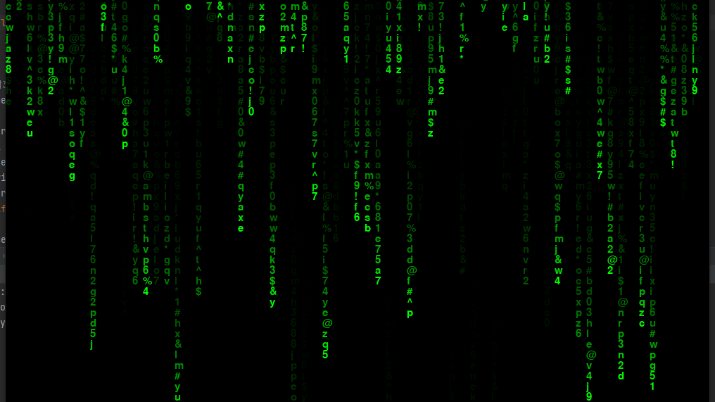
05
Performance
Analysis
Algorithm benchmarking and results

Slide 16
BENCHMARKING RESULTS
Algorithm Performance Comparison
Algorithm | Path Length | Nodes Explored | Time (ms) | Optimal
BFS | 11 | 15 | ~42.44 | yes
DFS | 11 | 12 | ~16.93 | ~yes
A* | 11 | 14 | ~27.90 | yes
Greedy | 11 | 14 | ~21.22 | ~yes
CSP | 11 | 14 | ~13.83 | yes
Key Findings
Trade-offs
Efficiency
•
All algorithms found the optimal 11-move solution
Completeness: All algorithms are complete for this problem size. Optimality: All find the optimal solution.
Efficiency: DFS is the Most Efficient Algorithm, while BFS explores most due to level-order traversal.
Time Complexity: All algorithms solved the problem in under ms, demonstrating Python's efficiency for this state space size. Space Complexity: DFS uses O(bm) space, BFS uses O(b^d), while A* space depends on heuristic quality.
•
A* explored the fewest nodes (19)
•
DFS was fastest in execution time
•
BFS explored the most nodes (15)
For this small state space, DFS's rapid depth-first exploration outperformed the overhead of informed search (A*) and systematic breadth-first exploration (BFS).

Slide 17
TECHNICAL ACHIEVEMENTS
Implementation Highlights
Modular Interface
Smooth Animation
Audio Integration
Consistent solve() function across all algorithms enables easy swapping and comparison without code changes.
Three-phase animation system with configurable speed, pause/resume, and real-time scene updates using Tkinter's after() method.
Pygame mixer for background music with volume slider, toggle controls, and graceful file-not-found handling.
Cycle Detection
Real-time Metrics
Prevents revisiting states using closed sets, ensuring efficient exploration without infinite loops.
Cross-Platform GUI
Performance data collection and overlay display showing algorithm statistics during simulation.
Custom button rendering with hover effects, responsive layouts, and consistent appearance across operating systems.
Code Quality & Extensibility
The project demonstrates clean architecture with separation of concerns: algorithms, core logic, and GUI are independent modules. Adding new search algorithms requires only implementing the solve() interface and registering in the GUI solver dictionary. The animation system is decoupled from search logic, allowing visualization of any solution path.

Slide 18
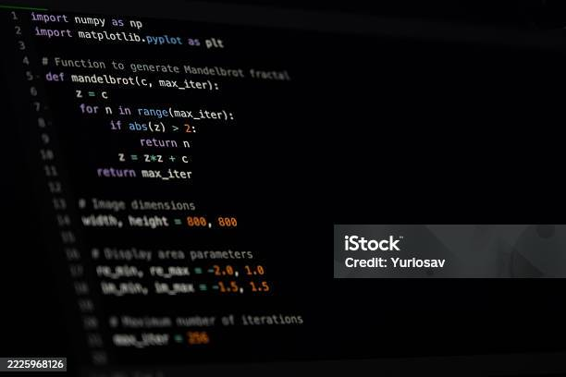
Key Takeaways
AI Concepts
Modular Design
Visual Learning
Demonstrates classic search algorithms through interactive visualization, making abstract concepts tangible and understandable.
Clean architecture enables easy algorithm extension. New solvers can be added by implementing a single function interface.
GUI provides intuitive understanding of state space exploration and algorithmic trade-offs through animated visualization.
This project bridges theory and practice, transforming classical AI problems into engaging interactive experiences. The combination of rigorous algorithm implementation with intuitive visualization creates an effective educational tool for understanding search strategies and computational thinking.
Python 3.13
Tkinter GUI
5 Algorithms
Open Source

